Slide 1
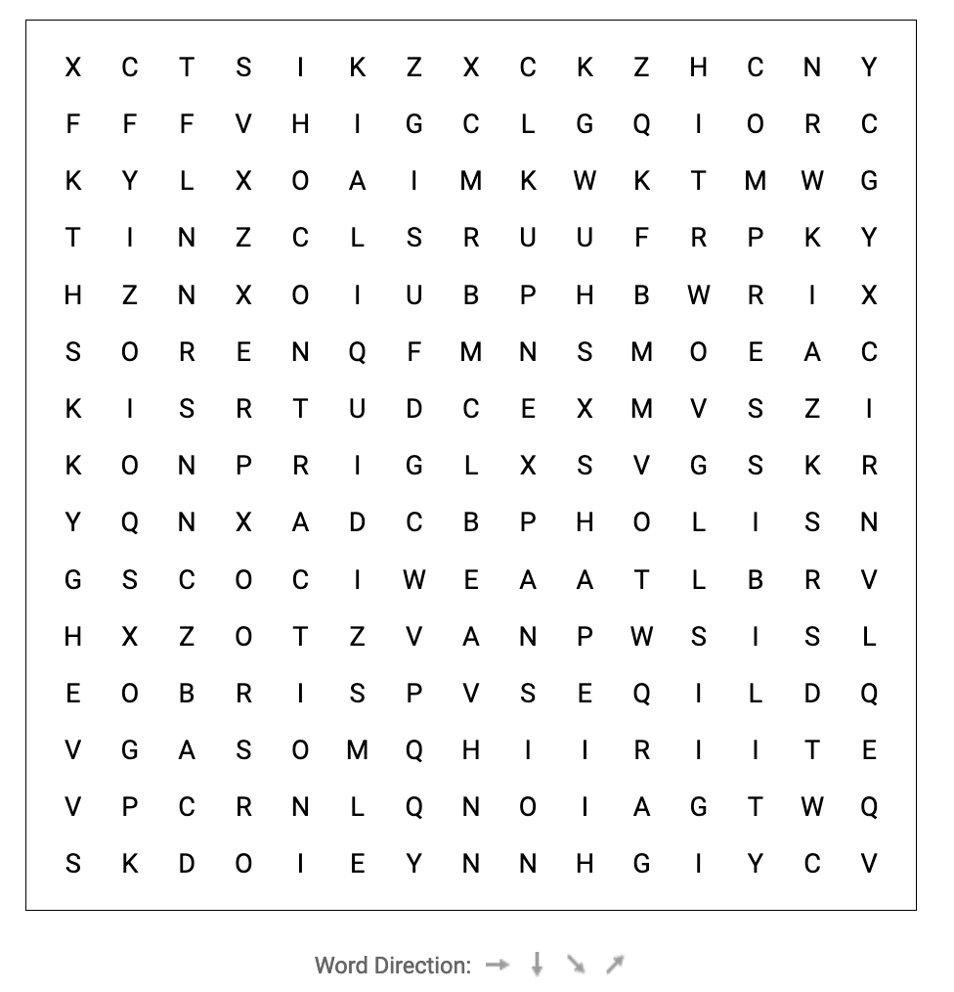
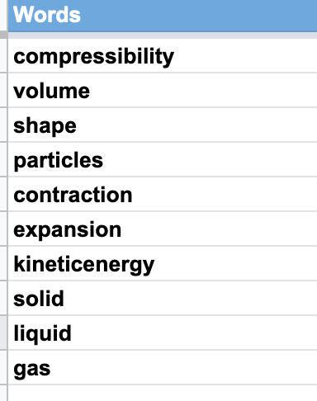
DO NOW
Find 10 words to do with particle theory….

Slide 2
Atoms and Elements Year 8 Science

Slide 3

Learning Objectives
CFU
What two things are we comparing and contrasting?
Compare and contrast atoms and elements.
Describe how elements are arranged on the periodic table.
Activate Prior Knowledge
How many chemical elements can you think of in 2 minutes?
Write their names on your whiteboards.

Slide 4
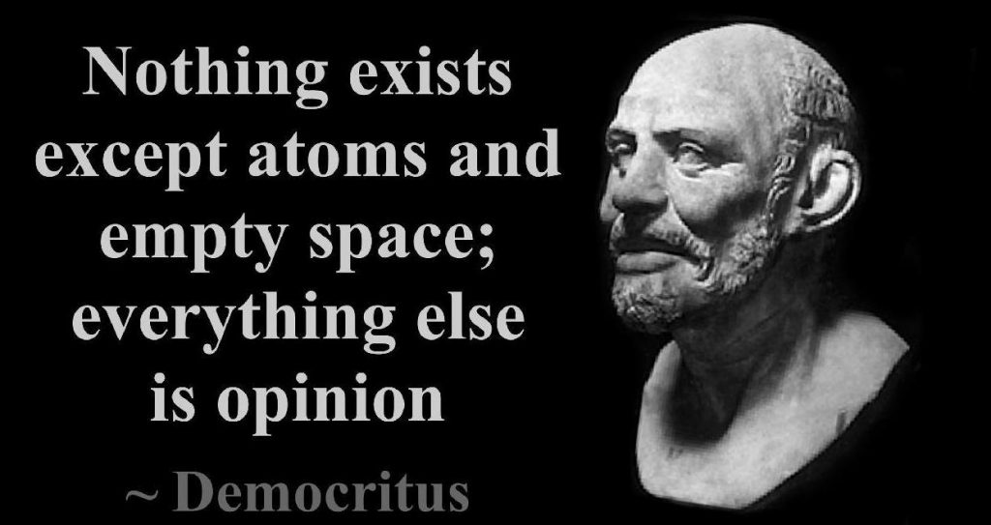
Concept Development
CFU 1
What idea did Democritus propose?
Atom: Smallest particle of matter that cannot be created, destroyed or broken down
Element: Pure substance made of only one type of atom.
CFU 2
Where does the word ‘atom’ come from?
Democritus, a Greek philosopher, proposed the idea that all matter is made of particles (incredibly small bits of matter).
He called these particles atomos, which is Greek for ‘indivisible’, because he suggested that particles cannot be cut up into smaller pieces.
This is the origin of the word atom.

Slide 5
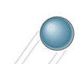

Concept Development
CFU 1
What is an atom?
Element: a substance that is made up of just one type of atom.
Different elements have different properties, such as:
colour,
mass,
melting / boiling points,
electrical conductivity,
and many others.
Atom: a particle that is unable to be broken down any further.
CFU 2
How is an element different to an atom?
CFU 3
What sort of properties do elements share?

Slide 6
Concept Development
Atoms are classified as metals, non-metals or gases (week 5).
Some gases are monatomic – An element that consists of just single atoms. Only six of the 92 naturally occurring elements being monoatomic. These are non-metallic gases.
e.g. Neon and Helium
Others are diatomic – they join together in pairs
e.g. Nitrogen, Oxygen and Hydrogen
CHORAL RESPONSE!
Monatomic → single atom
Diatomic → join in pairs

Slide 7
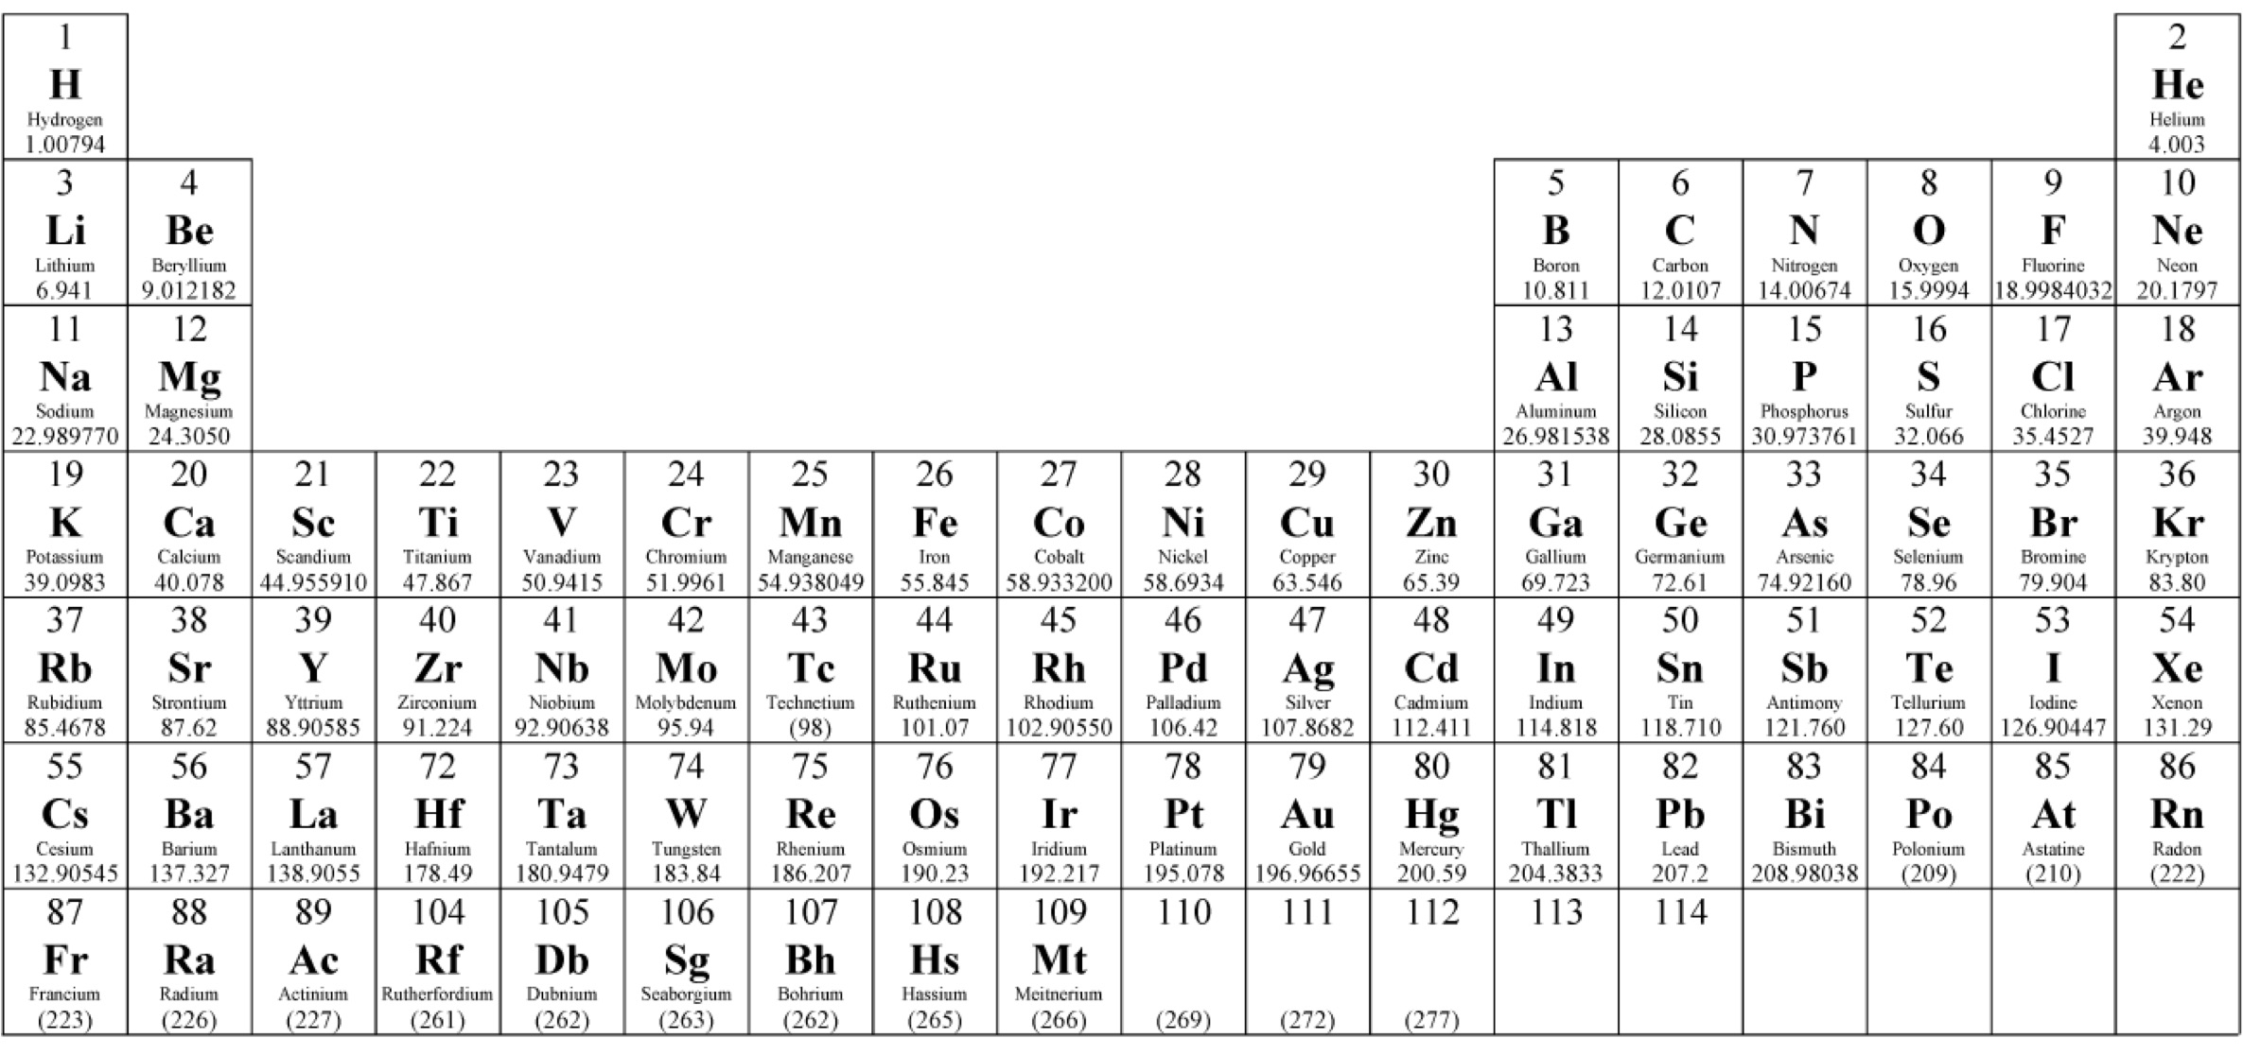
Concept development
CFU 1
What period is the element carbon (C) in?
Periods: horizontal rows on the periodic table
We give each period a number, starting from the top.
CFU 2
What period is the element sodium (Na) in?
CFU 3
Name an element that is in period 1.
Period 1
Period 2
Period 3
Period 4
Period 5

Slide 8
Concept Development
CFU 1
What group is the element carbon (C) in?
Groups: vertical columns on the periodic table.
We give each group a number, starting from the left.
CFU 2
What group is the element sodium (Na) in?
CFU 3
What group is the element helium (He) in?
Group 12
Group 13
Group 14
Group 15
Group 16
Group 17
Group 10
Group 18
Group 1
Group 11
Group 2
Group 4
Group 5
Group 6
Group 7
Group 8
Group 3
Group 9

Slide 9
Skill Development / Guided Practice
CFU 1
What is another element in the same group as aluminium?
All of the elements discovered so far are arranged on the Periodic Table in periods (rows) and groups (columns).
CFU 2
What is another element in the same period as aluminium?
We can now identify an element by its period and group.
Which element is in period 3, group 13?
Aluminium
Group 13
Period 3

Slide 10
Skill Development / Guided Practice
CFU 1
What is another element in the same group as iron?
All of the elements discovered so far are arranged on the Periodic Table in periods (rows) and groups (columns).
We can now identify an element by its period and group.
Which element is in period 4, group 8?
Iron
CFU 2
What is another element in the same period as iron?
Group 8
Period 4

Slide 11
Relevance
Knowing about groups and periods of elements allows us to identify elements with similar properties to each other.
Having a periodic table that scientists all share and agree on allows us to communicate with ease.

Slide 12
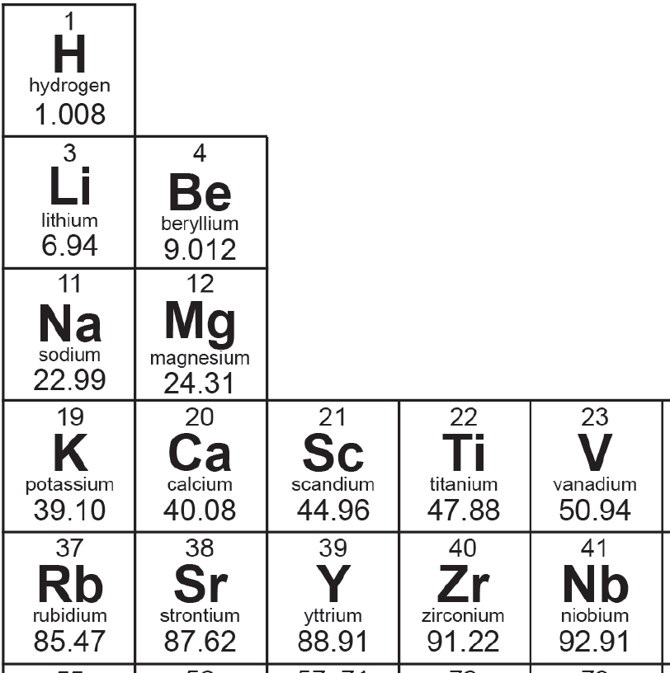
Concept Development
CFU 1
What are elements represented by on the periodic table?
Scientists use symbols to represent the names of different elements.
CFU 2
How many letters make up an element symbol?
On the periodic table, you will notice that elements are represented by their symbols.
Element symbols consist of one or two letters.
Element symbols: The first letter is always a capital, and if there is a second letter it is always in lower case.
CFU 3
How must all element symbols be written?

Slide 13
Skill Development / Guided Practice
CFU 1
The symbol for fluorine has one letter – what is it?
Element symbols always start with a capital letter. If a second letter is used, it is always written in lower case.
CFU 2
The symbol for bromine has two letters – what are they?
Most element symbols match the first letter and sometimes the second letter of the element name.
What is the element symbol for:
Hydrogen
Carbon
Iodine
Neon
Gallium
Calcium
H
C
I
Ne
Ga
Ca

Slide 14
Skill Development / Guided Practice
CFU 1
Where have the second letter in each of these element symbols come from?
Element symbols always start with a capital letter. If a second letter is used, it is always written in lower case.
Some element symbols match the first letter, but the second letter is not the same as the element name.
CFU 2
Arsenic is number 33 on the periodic table. What is its element symbol?
What is the element symbol for:
Magnesium
Chlorine
Zinc
Mg
Cl
Zn

Slide 15
Skill Development / Guided Practice
CFU 1
If an element’s symbol does not match its name, where does it usually come from?
Element symbols always start with a capital letter. If a second letter is used, it is always written in lower case.
Some element symbols do not match the element name.
These symbols have been taken from the Latin name of the element.
What is the element symbol for:
Sodium
Iron
Potassium
Copper
Silver
Tin
Gold
Lead
Na (natrium)
Fe (ferrum)
K (kalium)
Cu (cuprum)
Ag (argentum)
Sn (stannum)
Au (aurum)
Pb (plumbum)
CFU 2
Antimony is number 51 on the periodic table - what is its element symbol?

Slide 16
Kahoot!! ☺

Slide 17
Independent Practice
Answer the following questions in your workbook or on your device. Whenever you write the name of an element, write its symbol as well.
Which element is in period 2, group 6?
Which element is in period 5, group 11?
Which element is in period 4, group 18?
Which element is in period 3, group 13?
Write the period and group for the following elements:
Calcium
Argon
Gold
Copper
Mercury
Fluorine
Selenium
Manganese
Write the name of an element in the same group as:
Nickel
Cobalt
Nitrogen
Gallium
Write the name of an element in the same period as:
Lithium
Helium
Neon
Silicon

Slide 18
Independent Practice
ANSWERS
Answer the following questions in your workbook or on your device. Whenever you write the name of an element, write its symbol as well.
Which element is in period 2, group 6?
Which element is in period 5, group 11?
Which element is in period 4, group 18?
Which element is in period 3, group 13?
Write the period and group for the following elements:
Calcium P4, G2
Argon P3, G18
Gold P6, G11
Copper P4, G11
Mercury P6, G12
Fluorine P2, G17
Selenium P4, G16
Manganese P4, G7
Write the name of an element in the same group as:
Nickel Pd, Pt, Ds
Cobalt Rh, Ir, Mt
Nitrogen P, As, Sb, Bi, Mc
Gallium B, Al, In, Tl, Nh
Write the name of an element in the same period as:
Lithium Be, B, C, N, O, F, Ne
Helium H
Neon Li, Be, B, C, N, O, F
Silicon Na, Mg, Al, P, S, Cl, Ar
Chromium
Silver
Krypton
Aluminium

